Slide 1


Human capital mediates natural selection in contemporary humans
David Hugh-Jones (University of East Anglia)
Abdel Abdellaoui (Amsterdam UMC)
Notes:
Move on!!

Slide 2
Contemporary humans are undergoing natural selection on polygenic scores (Barban et al. 2016; Beauchamp 2016; Kong et al. 2017; Sanjak et al. 2018).
But we have no theory of why.
We examine natural selection on 33 polygenic scores in UK Biobank.

Slide 3
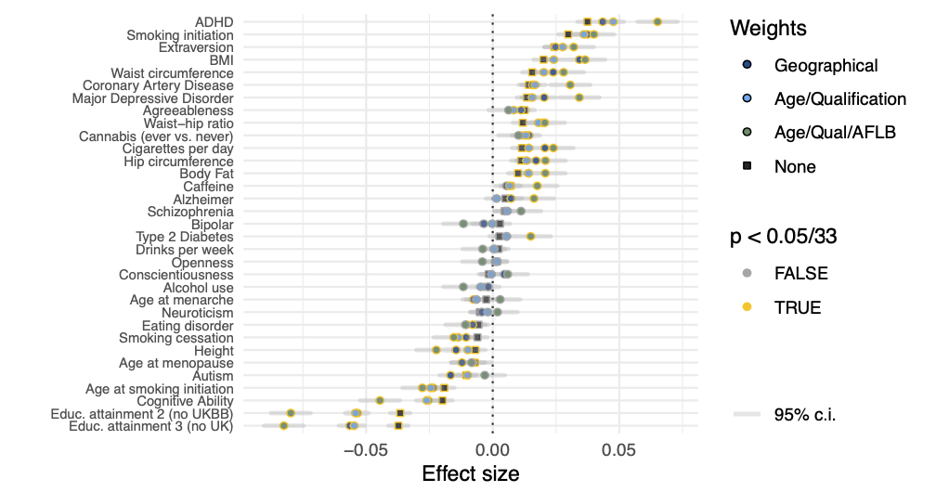
Correlations with completed fertility
Notes:
Each row here is one polygenic score. Plots are bivariate correlations with completed fertility. Scores with positive correlations (e.g ADHD, BMI) are being selected for. Scores with negative correlations are being selected against.
UKBB has ascertainment bias. When we correct for this, effect sizes are larger.

Slide 4
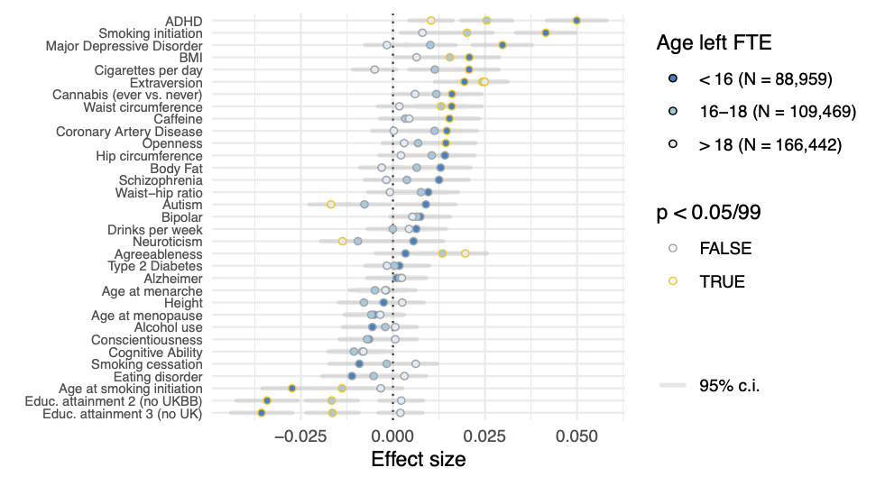
Education
Notes:
We split our sample into subgroups. Here we’ve split by age leaving full time education. Effects are larger and more significant for those leaving education early.

Slide 5
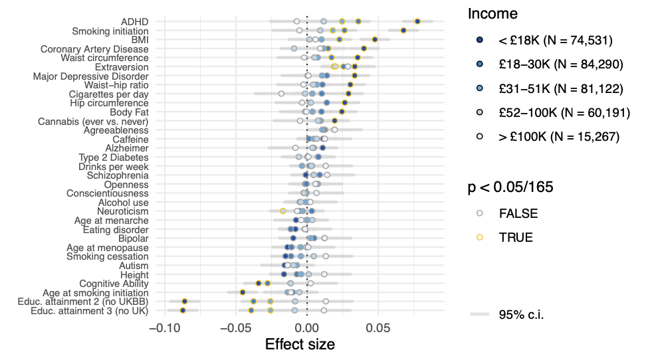
Income
Notes:
Effects are larger among low-income households.

Slide 6
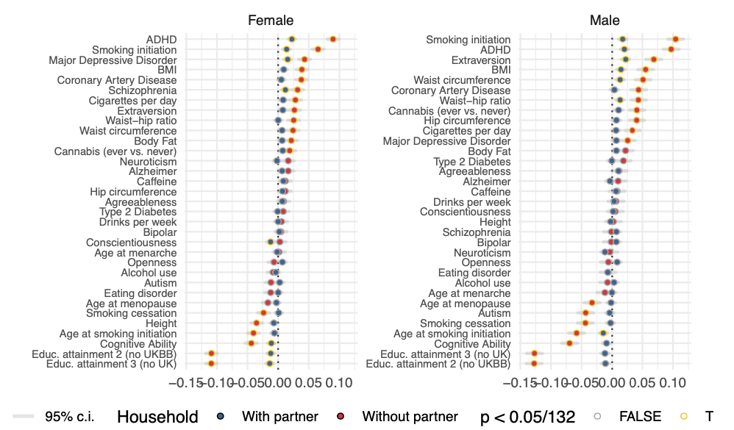
Household structure
Notes:
Effects are larger for people not living with a partner.

Slide 7
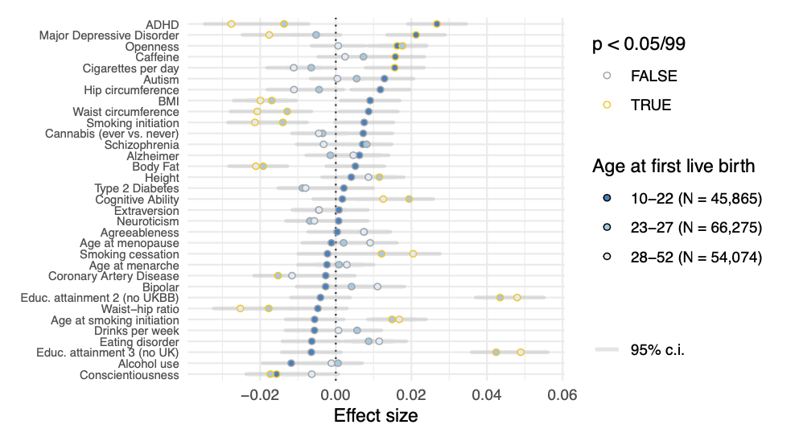
Age at first birth
Notes:
Effect sizes are actually reversed among older mothers.
One caveat: these categories are not exogenous to polygenic scores. For example, a PGS may affect fertility condition on age at first live birth, but also may affect your age at first live birth. Nevertheless, these patterns need explanation.

Slide 8

Model
By increasing a person’s expected wage, human capital has opposing effects on fertility (Becker 1960):
Children become more affordable (income effect)…
… but cost more in foregone wages (substitution effect)
A simple model of human capital and fertility choice explains the key patterns in our results.
Notes:
Gary Becker argued that, by increasing a person’s wage, human capital has two opposing effects on fertility: children become more affordable, but they cost more in foregone wages. We write down a simple model of human capital and fertility choice, and it explains the patterns I’ve just shown you.

Slide 9
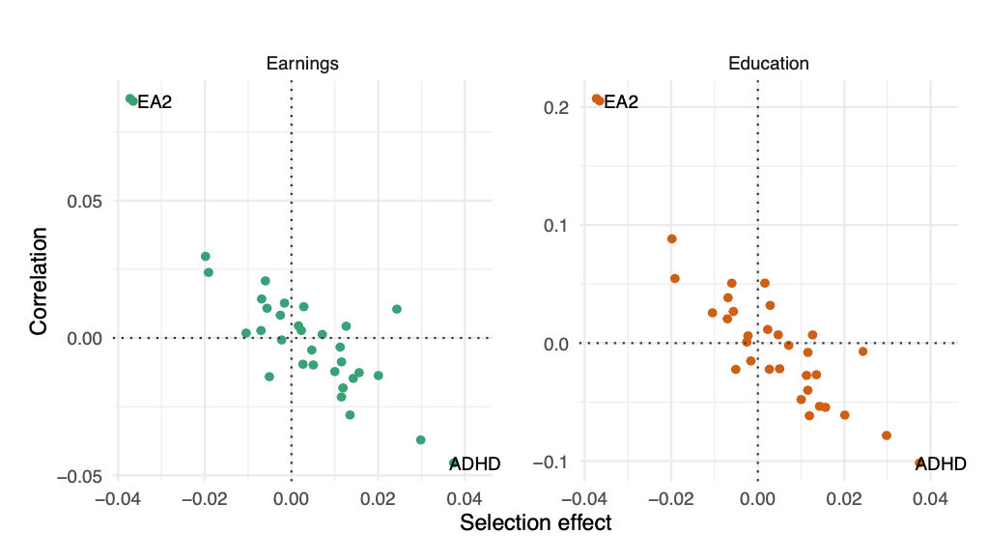
PGS which correlate negatively with earnings and education are selected for
Notes:
To test this theory we correlate our polygenic scores with earnings. Scores which correlate negatively with earnings and education are selected for. Those which correlate positively with earnings and education are selected against.

Slide 10
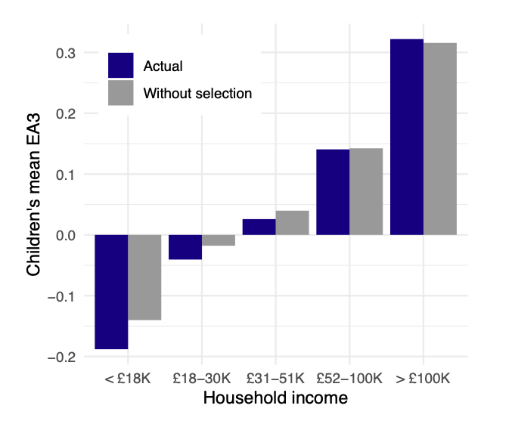
Effects
Effects on population means are small.
But noisy PGS imply errors-in-variables.
Ascertainment into UKBB seems to bias results towards 0.
Effects on inequality are substantive.
Results increase inequality for 29 out of 33 scores.
Median increase in difference between highest- and lowest-income groups: 14% in 1 generation.
Notes:
Because correlations with fertility are larger in low income groups, they increase the genetics-SES gradient. The median polygenic score’s difference between highest and lowest income groups increases by 14% over 1 generation.
If genetics matters for explaining differences across economic groups, then these changes are substantial.

Slide 11
SAPERE AUDE
Thank you!

Slide 12
Extra material

Slide 13
We examine the previous generation using number of siblings.
Results have the same pattern, no evidence of change in effect sizes.
Larger effect sizes for parents in more deprived areas.
Notes:
Results are essentially the same in the previous generation.

Slide 14
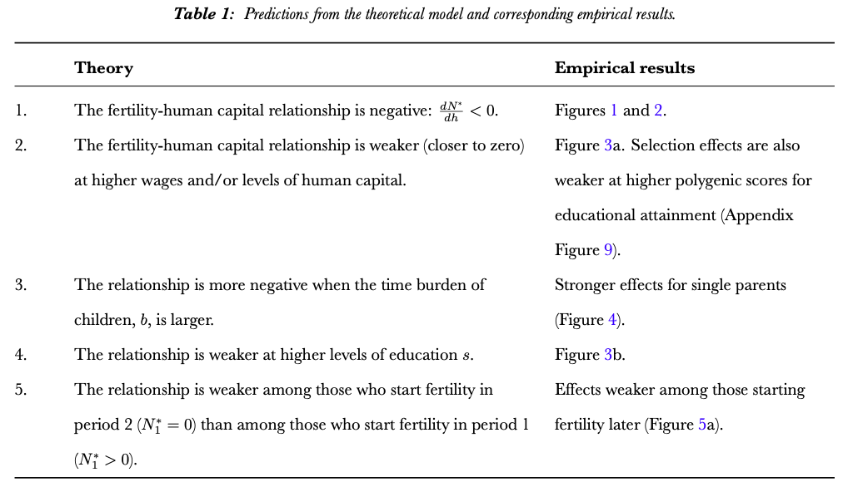

Slide 15
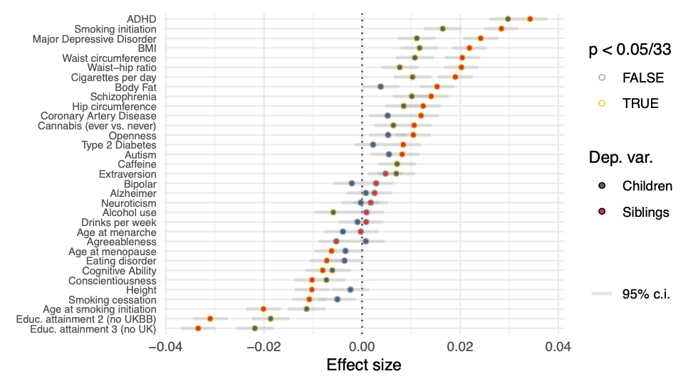

Slide 16
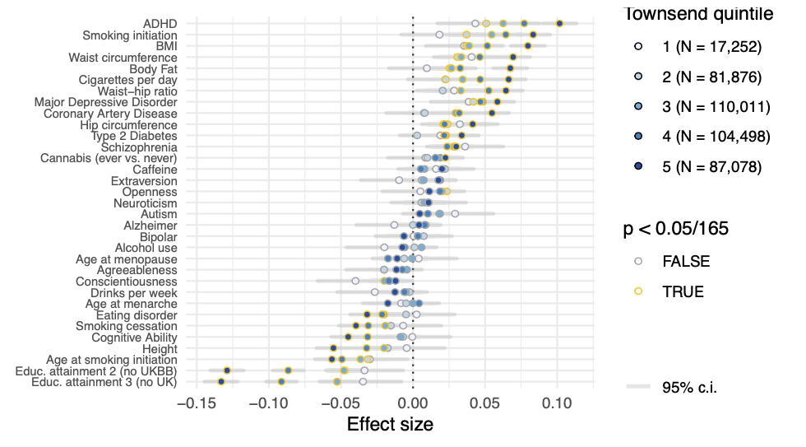

Slide 17
